Slide 1
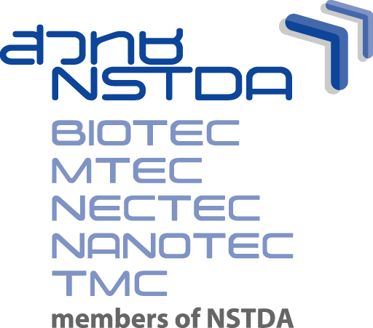
Overview: NSTDA Strategy for Building Human Intellectual Capital for Thailand 4.0
inco@nstda.or.th, International Collaboration National Science and Technology Development Agency
Chanwit Tribuddharat, M.D., Ph.D.
Acting Vice President for International Collaboration
January 26, 2018
Thailand Science Park, Pathum Thani
Notes:
1
1
1

Slide 2
NSTDA at a glance
Establishment: December 1991 by Science and Technology Development Act, 1991, as an autonomous government agency
Vision: “NSTDA is a key partner towards a Knowledge-based Society using science and technology.”
Missions:
Key units:
Human resource: 2,993 employees (as of 31 August 2017)
Research & Development
Human Resource Development
Technology Transfer
S&T Infrastructure
BIOTEC
NECTEC
MTEC
NANOTEC
TMC
AgriTech
1,911 Researchers (68.54%)
237 Managements (8.50%)
640 Operations (22.96%)
599 Ph.D.s
(21.49%)
1,238 Masters
(44.40%)
951 Bachelors & Others
(34.11%)
Notes:
In December 1991, the National Science and Technology Development Agency (NSTDA) was established under the Ministry of Science and Technology by the special National Science and Technology Development Act, 1991. NSTDA is an autonomous entity reporting to the Governing Board chaired by the Minister of Science and Technology.
Vision: “NSTDA is a key partner towards a Knowledge-based Society using science and technology.”
NSTDA plans and executes four mandated missions:
research and development,
technology transfer,
human resources development
and S & T infrastructure development.
NSTDA is comprised of four national research centers:
the National Center for Genetic Engineering and Biotechnology (BIOTEC,
the National Metal and Materials Technology Center (MTEC),
the National Electronics and Computer Technology Center (NECTEC)
and the National Nanotechnology Center (NANOTEC).
To tie all these organizations together, the Technology Management Center (TMC) of NSTDA serves as a linkage between scientists and end users, and it provides applicable technology services.
AgriTech : Agricultural Technology and Innovation Management Institute
In addition, NSTDA reaches out to other research organizations and universities through joint collaboration, contracted research, and other mechanisms to ensure the best resources are being captured for the country’s innovation needs.
In brief, NSTDA is a one of a kind national organization that distinguishes its roles from other research units in Thailand by acting as a bridge between the academic research and innovation requirements of industry.
NSTDA has 2,695 staff and researchers are the majority at 68%. About 20 % of NSTDA personnel have

Slide 3
NSTDA: an Autonomous Agency
NSTDA Board
chaired by Minister of Science and Technology
(established by NSTD Act of 1991)
Graduates
280, 52%
Studying Students
241, 48%
AgriTech
NSTDA : National Science and Technology Development Agency
BIOTEC : National Center for Genetic Engineering and Biotechnology
MTEC : National Metal and Materials Technology Center
NECTEC : National Electronics and Computer Technology Center
NANOTEC : National Nanotechnology Center
TMC : Technology Management Center
AgriTech : Agricultural Technology and Innovation Management Institute

Slide 4
NSTDA Research and Development Strategy
Cluster-based Research Networking
Agriculture & Food Energy & Environment Health & Medical Manufacturing Industries Bioresources Cross-cutting Technology
1
Food for the Future
2
3
Next Gen Automotive & Logistics
Public Health &
Quality of LIfe
Targeted Research
4
5
Biofuels and Biochemicals
Modern Agriculture
Sensors
HPC & Data Analytics
Biomaterials
3 Integrated Technology Platforms
4 Technology Platforms (32 unit research, 101 laboratories)
Biotechnology Digital Technology Material Technologies Nanotechnology

Slide 5
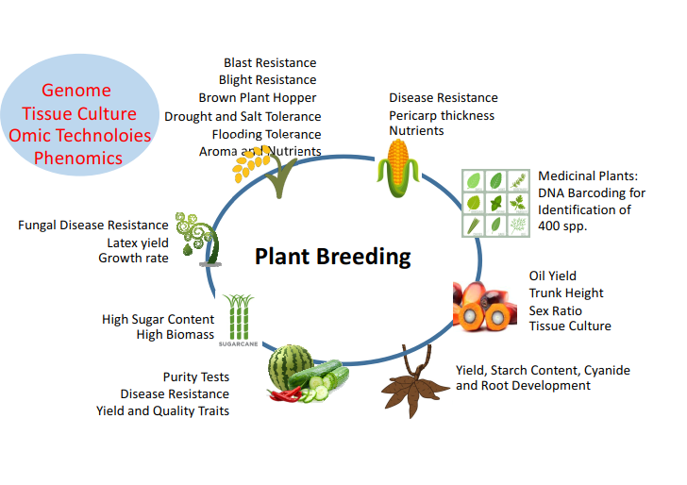

Slide 6
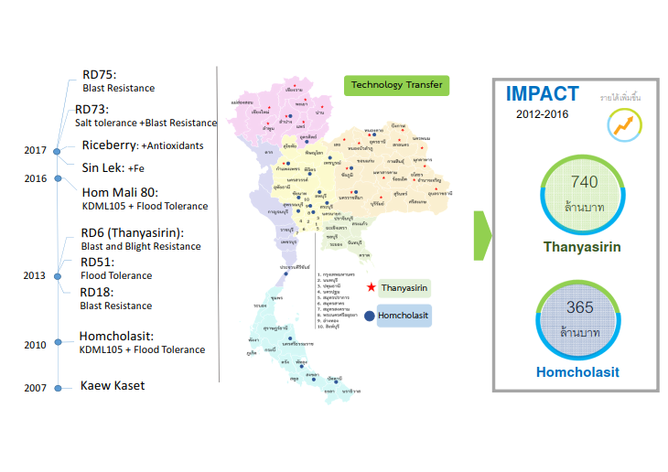
Mil Baht
Mil Baht

Slide 10
Medical Research
Drug
Vaccine
Second Gen Vaccine NSTDA-II
Antimalarial
Diagnostic Kits
Aiding System for Medical Diagnosis
Dengue
“DEN-STEP”
TB DNAsensor Kit
Malaria dewtection kit
Alpha Thalassemia
Impact
ASEAN Medical Hub by 2025

Slide 12
NECTEC
Notes:
TRM: Technology road map

Slide 13
NECTEC

Slide 14
MTEC

Slide 15
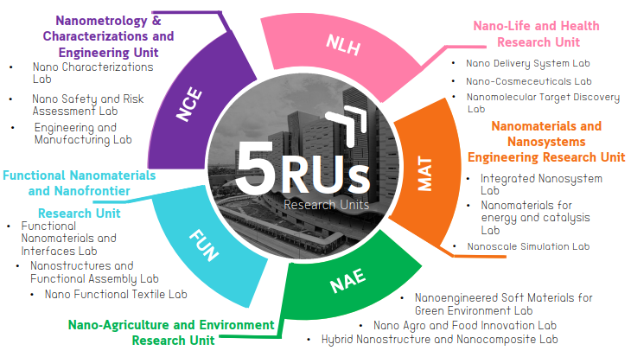
NANOTEC

Slide 22
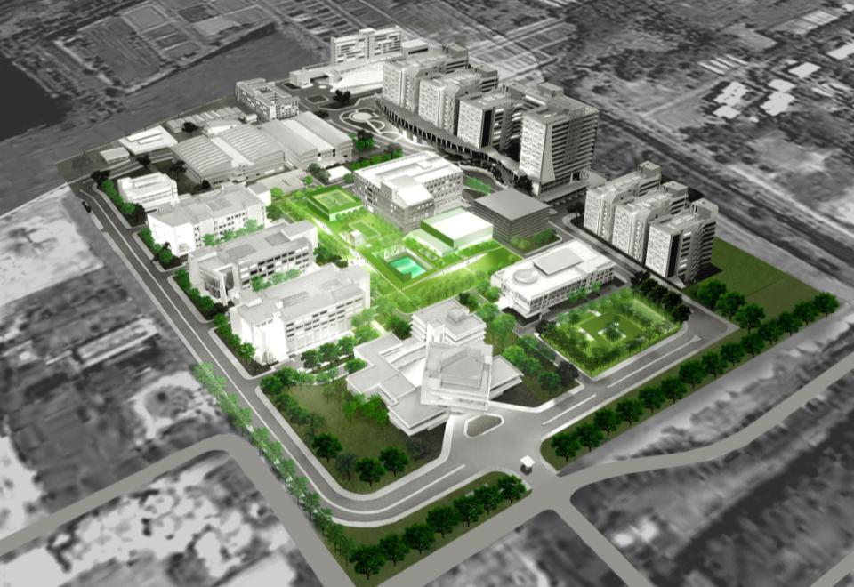
S&T Community in TSP
Residential Area
Innovation Cluster 2
Convention
Center
Pilot Plants
FUTURE DEVELOPMENT
Garden of Innovation
Innovation Cluster 1
(Multi-Tenants Unit)

Slide 23
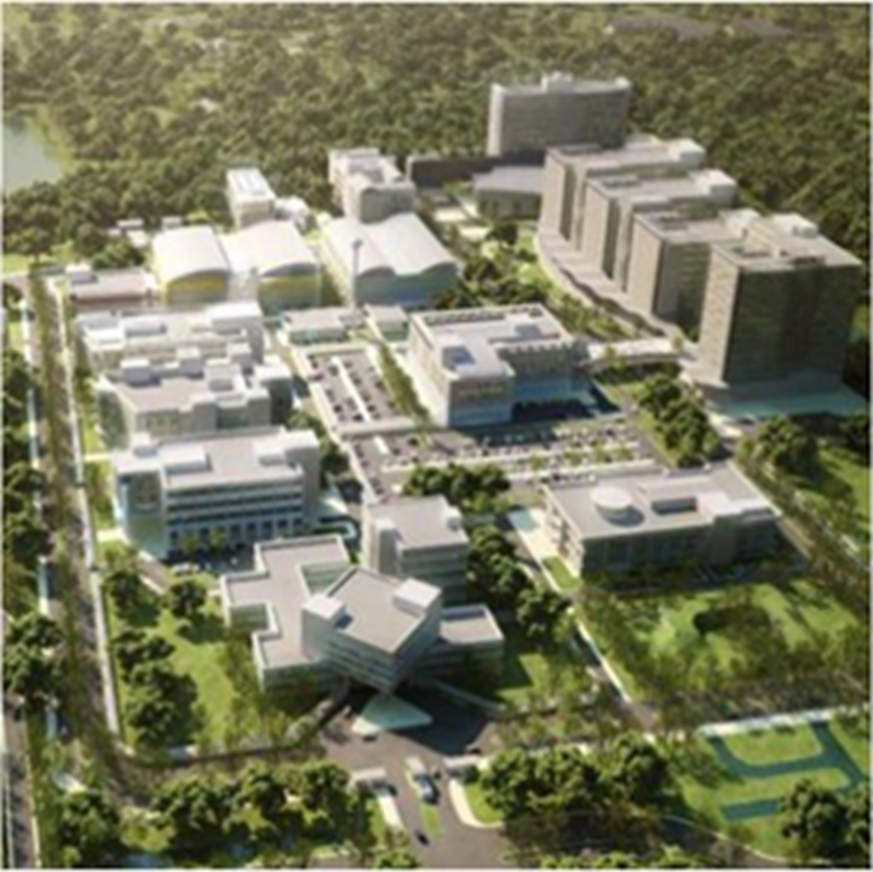
THAILAND SCIENCE PARK
Infrastructure to support S&T Development
Established in 2002 as Thailand First & Fully Integrated Hub for R&D
Houses Headquarter of National Science and Technology Development Agency (NSTDA) and its 4 National Research Centers
> 70 technology companies
around 30% are International Firm
> 500 R&D projects/year
Joint/Contract project 45-50 %
Objectives:
Provide High Quality R&D Space for Public and Private Sector.
Incubate Technology Business Start-ups
Support Linkage between Private Companies, NSTDA, and Universities.
Notes:
TSP is the country’s first science park dedicated to r & D in science and technology.
It was established by the Ministry of Science and technology to be an innovation hub for the private sector’s industrial R & D activities.
The park began its operations in 2002 under the management of the NSTDA.
It is also home to Head Quarter NSTDA and 4 National Research Centers plus more than 70 technology companies.
TSP is an ideal location for companies to set up their R&D based operation in Thailand.
In TSP, there are pilot plants, incubators, service centers, conference & exhibition area, training centers and space for rent.
Tenants of TSP gain access to S&T support such as research labs and related facilities, a large pool of over 600 full-time scientists and researchers and a network of universities. They also enjoy privileges and incentives from the Thai government.

Slide 24
Mission: Human Resource Development

Slide 25
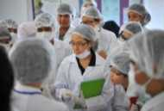
Preparing S&T Human Resources
Basic Education
Higher Education
Professional Researchers
Primary Education
Bachelor – Doctoral Degrees
High School
Researchers
Professionals
Science Learning Promotion
Inspiring Kids to join Science Programs
Graduate Capacity Building
Entering Research Careers
Professional Education
Young Scientist and Technologist Program (YSTP)
Sirindhorn Science Home
Thailand Graduate Institute of Science and Technology (TGIST)
New Entrepreneur Education
Children’s University
Junior Science Talent Project (JSTP)
NSTDA-University-Industry Research Collaboration (NUI-RC)
Little Scientists’ Home
Thailand Advanced Institute of Science and Technology (TAIST)
Personnel are supported by National Research Centers, Thailand Science Park,
and members of Innovation Clusters (universities and private sectors)
Notes:
25

Slide 26
10 targeted industries with investment privileges
5 existing industries (First 5 S-Curves)
Next-Generation Automotive
Smart Electronics
Affluent, Medical and Wellness Tourism
Agriculture and Biotechnology
Food for the future
5 new industries (New 5 S-Curves)
Robotics
Aviation and Logistics
Biofuels and Biochemicals
Digital
Medical hub

Slide 27
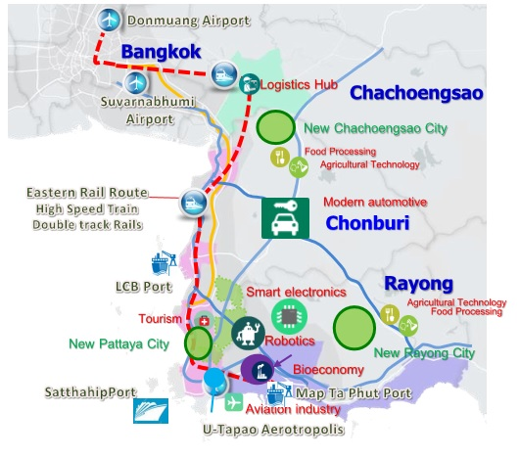
Eastern Economic Corridor (EEC) and Eastern Economic Corridor of Innovation (EECi)
Infrastructure
Business, Industrial clusters and Innovation hub
Tourism
New cities and communities

Slide 28
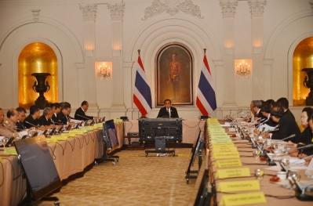
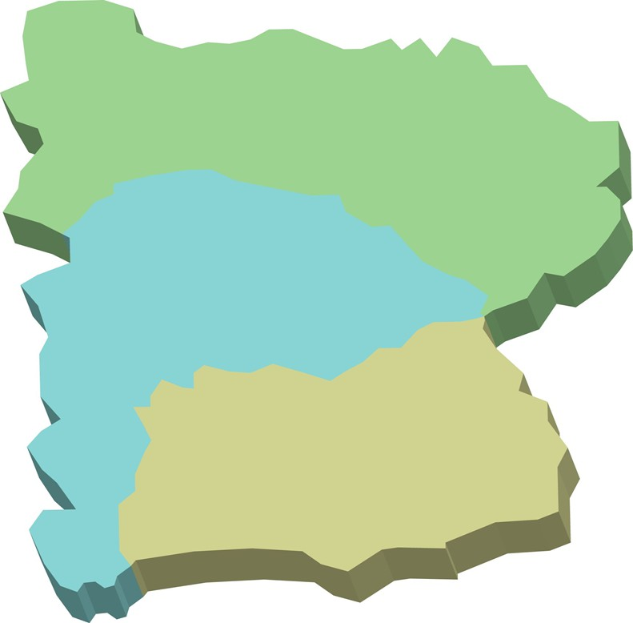
IV. EECi is part of the EEC Development
New Cities of EEC
Gateway City
EECi
New City
Chachoengsao
Cholburi
Burapa Univ.
Amata City
Kasetsart University, Sriracha Campus
Rayong
Announcement of EECi on
17 November 2016
New City
New City
New City
Map Ta Phut
Ref.: Ministry of Transport

Slide 29
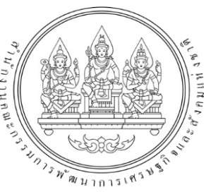
V. EECi is added into the EEC Act
DEC 2559
2
Additional information on
“Innovation"
Additional information on
“Innovation"

Slide 30
BOI Privileges & Incentives For R&D, Scientific Laboratories Engineering Design, Calibration, Electronics Design
Import Tax Exemption for Machineries
Corporate Income Tax Exemption for 8 Years
50% Corp. Income Tax Reduction for 5 more Years after Tax Exemption Period Ends
Corporate income tax exemption without cap
Work Permit and Visa Facilitation for Foreign Specialists and Researchers
Revenues from selling R&D products get same tax exemption
Notes:
I believe u know about the BOI and their incentives in R&D as well. BOI is very much supporting in Biotechnology so w have maximum incentives here for 8 years and waive for corporate tax 50% for the next 5 year. And Import tax exemption for machine and accelerate depreciation and allow for foreign ownership.
As well as RDC, they have incentive in term of accelerate depreciation for equipment and machinery and double deduction for R&D expenses, meaning if you spend a hundred Baht, you put down 200 B for those expenses before you ..the profit.

Slide 31
VI. Designated Area: Wangchan Valley, Wangchan, Rayong by PTT
Area of 800 Acres
Highway 334
Recreation Area & Commercial Zone (200 Acres)
Multi Tenants Lab Area , Startups & Innovation Center, NQI (60Acres)
Testbed (30 Acres)
Strength: Good supportive infrastructure and approved policy from PTT
Weakness: cannot support high rise building and factories, elevated rocky range, remote from main transportation system
Present: VISTEC, KVIS, and Plantation Institute are developing the areas to be agricultural community
Phase I
Phase II

Slide 32
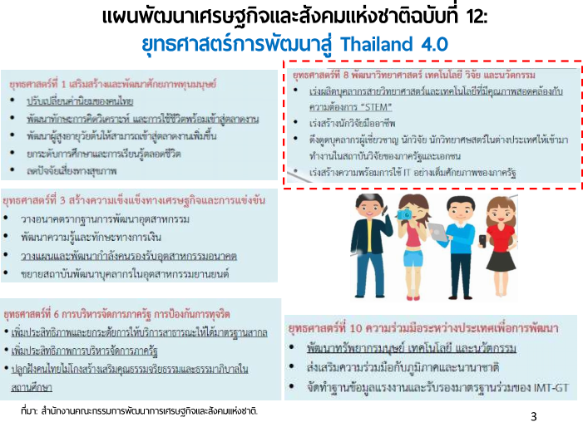

Slide 33
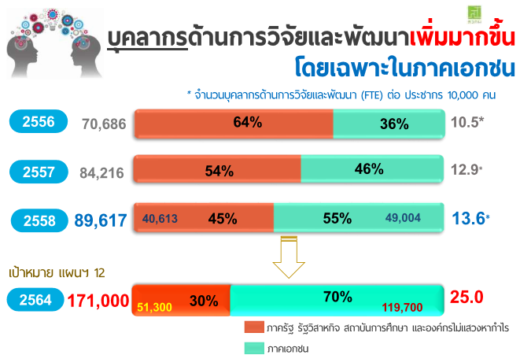

Slide 34
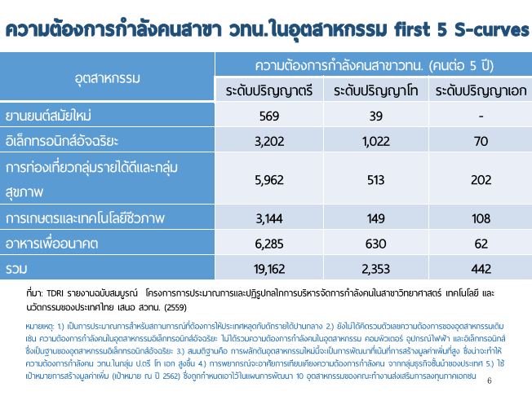

Slide 36
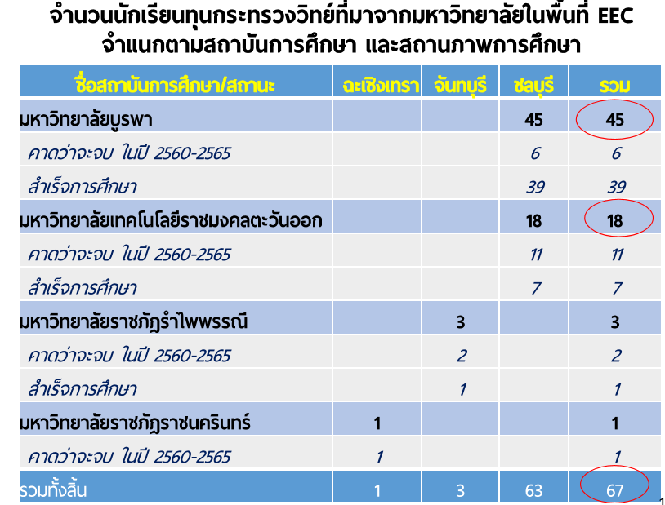

Slide 37
Foreign Policies and Thailand
China: One Belt, One Road
Japanese: Abe-nomics
Taiwan: South Bound
Australia: Same time zone
Europe: Horizon2020
UK: Newton/Flaming
Thailand: Brain circulation approach?

Slide 38
Much to Offer in EEC
Smart city/IoT
Safer home for elderly
True 24-hr hospital-linked services with health data
Green energy
High speed train: Link between 3 international airports
Expanded sea ports: Industrial/Commercial
Biopolis/Aripolis/Krenovapolis
Medical hub: Clinical research/Aging society

Slide 39
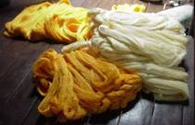
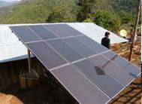
Thank you
A Driving Force for
National Science and Technology Capability
National Science and Technology Development Agency (NSTDA)
111 Thailand Science Park Phahonyothin Road, Klong Nueng, Klong Luang Pathum Thani 12120 Thailand
Email: inco@nstda.or.th
Notes:
39
39

