Slide 1
STEM Education for Thailand
ATPAC
Association of Thai Professionals in America and Canada

Slide 2
1. Summer Camps (NSF Pre-college programs)
NSF provides funding for universities to host Summer Camp for middle school and high school students to participate in the funded research projects of the professors
Private sectors host Summer Research Camp for middle school and high school students

Slide 3
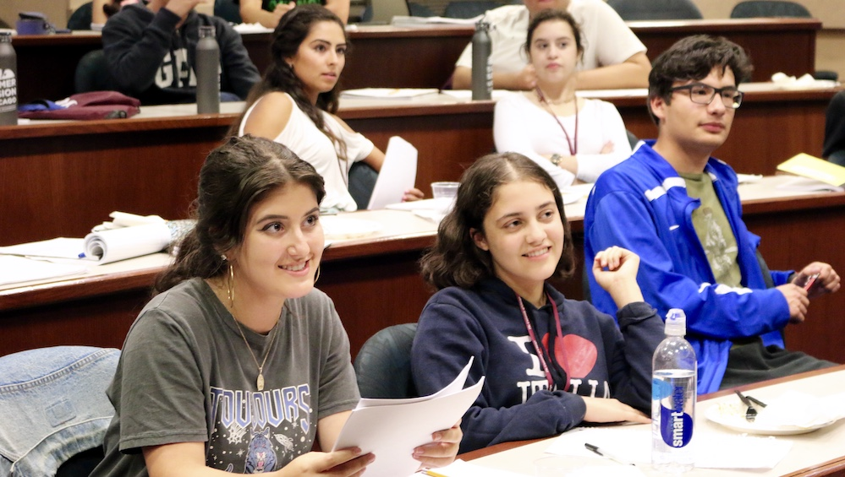
University of Chicago

Slide 4
2. Supplementary Fund for Research Grant
NSF provides supplementary funding for professors with funded research projects to support minority students (Thailand: modified to high school students) to work on the funded research projects
Very Simple process to receive additional fund: Just write a letter to NSF to request the supplementary fund with name of students

Slide 5
3. Incentive for College Admission
High school students in Thailand spend a lot of time and resources for tutoring (STEM destructive practice) in order to be successful with the college entrance exams
Initiative: provide admission option as incentive to high school students who have officially worked with college professors on their funded research projects (without taking the entrance exam)
Allow each program to admit 10-15% of their incoming freshmen through this program

Slide 6
Tutoring Schools in Thailand
STEM Destructive Practice

Slide 7
4. Research Grants for High School
Thai funding agencies initiate research program for high schools to compete to receive research grants
Provide one or two funded research projects per high school each year
High school students who receive/participate in these funded research projects will be admitted to college without taking the entrance exam

Slide 8
5. Top U.S. STEM High Schools: How do they Operate
Two top U.S. STEM high schools:
Thomas Jefferson (TJ) High School in D.C.
Lakewood (LW) High School in New Jersey
Each has their focus area:
TJ emphasizes on Biomedical
LW focuses on Semiconductor
40% of the instructors of TJ high school have Ph.D.
Funding sources: Government (Local and Federal) and Private Sectors (self fund raising)

Slide 9
TJ-Ivy league scholars

Slide 10
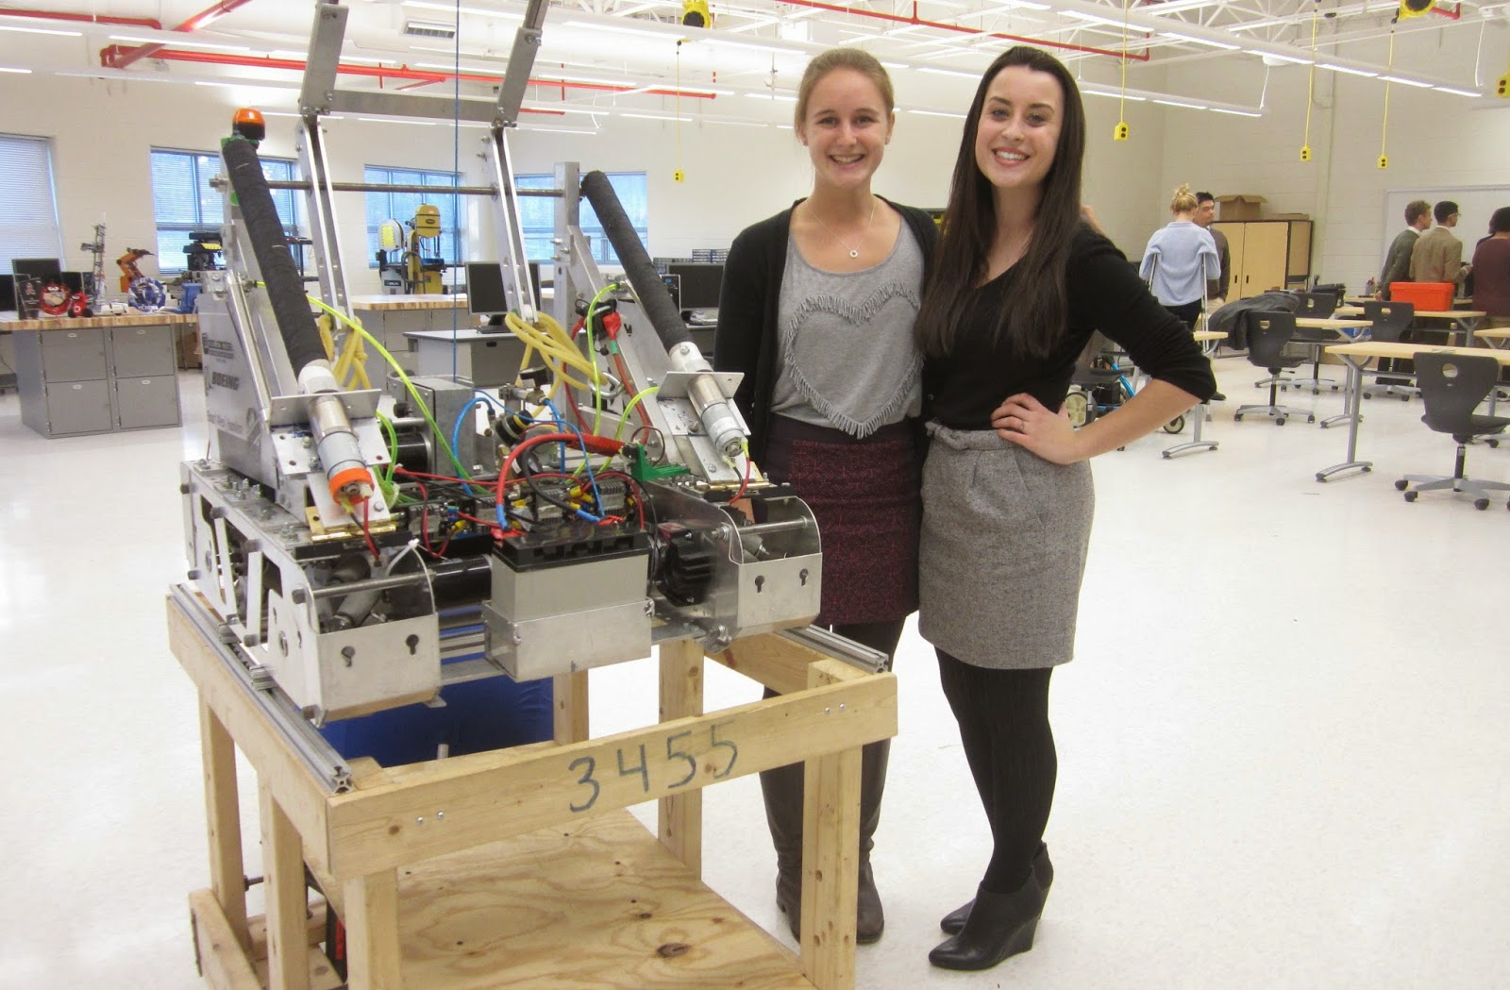

Slide 11
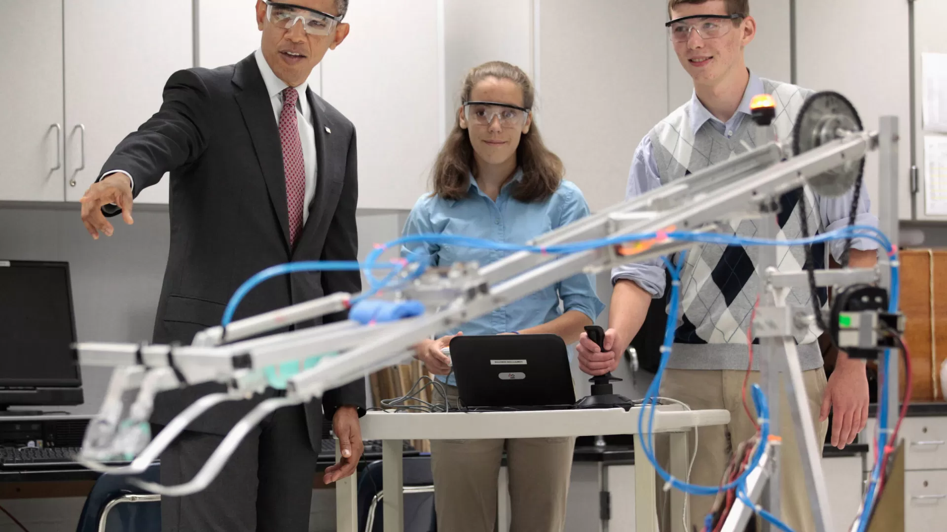
President Obama visited TJ in 2011

Slide 12
US-Thailand Joint Workshop on STEM Education
US-Korea Joint Workshop on Clean Coal Technology
Supported by the U.S. Department of Energy
US-Singapore Joint Workshop on High Performance Concrete
US-Singapore Joint Workshop on Concrete Durability
Supported by the U.S. National Science Foundation
US-India Joint Workshop on Fracture of Cementitious Composites
Propose:
US-Thailand Joint Workshop on STEM Education

Slide 13
How these bilateral workshops work?
Supported by the U.S. Funding Agencies
The program brings a team of U.S. experts, typically about 10-12 people, to Korea, Singapore, India, etc.
Host university, for example, in Singapore is National University of Singapore (NUS)
For the case of the US-Korea joint workshops, the meetings were organized both in the U.S. and in Korea
All workshops would generate a workshop proceedings in these areas of interest.

Slide 14
Second Generation of Thai Professionals in the U.S.
The proposed U.S.-Thailand joint workshops program can be utilized to recruit second generation of Thai Professionals in the U.S. to share their experiences with Thailand
Second generation in the U.S. are in the following areas:
Finance and Banking
Laws and Patents
Physicians and Medical Doctors
Engineers
University Professors and Higher Education
Advanced Technology and IT, etc.

Slide 15
Proposed Activities
It is time to bring teams of second generation Thai professionals in various focus areas from the U.S. to Thailand

Slide 16
Key Success Principle for Education:
“Learning should be fun”

